Slide 1
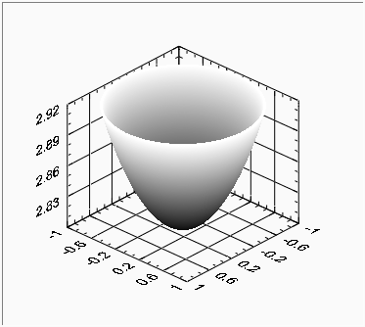
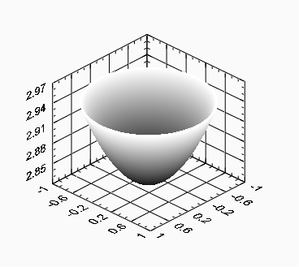
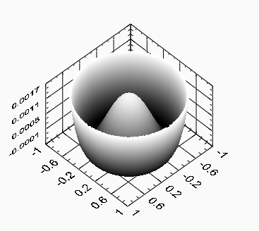
Spherical aberration funtion
Residual
(spherical aberration)
Total Aberration function
Piston + Defocusing
-
=

